Slide 1
Analysis of Glassdoor Reviews for S&P Global

Slide 2
Agenda
Executive Summary
Overview
Good Words about the Organization
3 Themes for Pros and Cons
What US and India Employees liked
Future Work Opportunities
Appendix

Slide 3
Executive Summary
Objectives
Identify hidden issues that might impacting employee experience.
Key Observations
Overall Employees were good with 3.3 Average overall satisfaction (out of 5).
Hot topics are Work Life Balance, Management, Work environment, People, Benefits, Brands, Leadership, Salary, Opportunities etc.
55% of the reviews are from US, India and UK employees and saw good representation from countries like – Philippines, Singapore, Pakistan etc.

Slide 4
Overview
2594
129
~ 20
30%
58%
42%
47%
73%
Reviews by former &
current employees
# Months
Average monthly reviews
Is the % of the employee from US
Of the reviews from current employees
Of the reviews from former employees
Avg. Recommender
Score
Approved Current CEO (on an Average)
Median = 3.0
Median = 3.3
Overall, Employees were more vocal from 2012 onwards, Review Count increasing, Median Avg. Overall Satisfaction ratio increased from 3.0 to 3.3
3.4
3.3
2008
2009
2010
2011
2012
2013
2014
2015
2016
2017
2018
2019
Average Overall Satisfaction
Number of reviews
54% Reviews from US, India and UK; Avg. Overall Satisfaction rate was good
Overall Employees are recommending Organization to others (with a good satisfaction level, more than 60%) , except the employees who spend 1 to 3 Yrs. in organization
489
240
US
India
UK
Philippines
Singapore
Pakistan
Argentina
France
HongKong
Others
Average overall satisfaction rating
Number of reviews
< 1 Yr
1 to 3 Yrs
3-5 Yrs
5-8 Yrs
8-10 Yrs
> 10 Yrs
Average overall satisfaction rating
Number of reviews

Slide 5
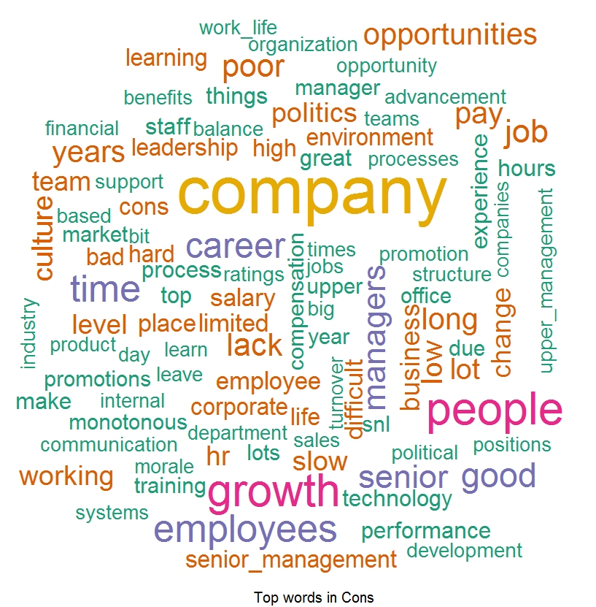
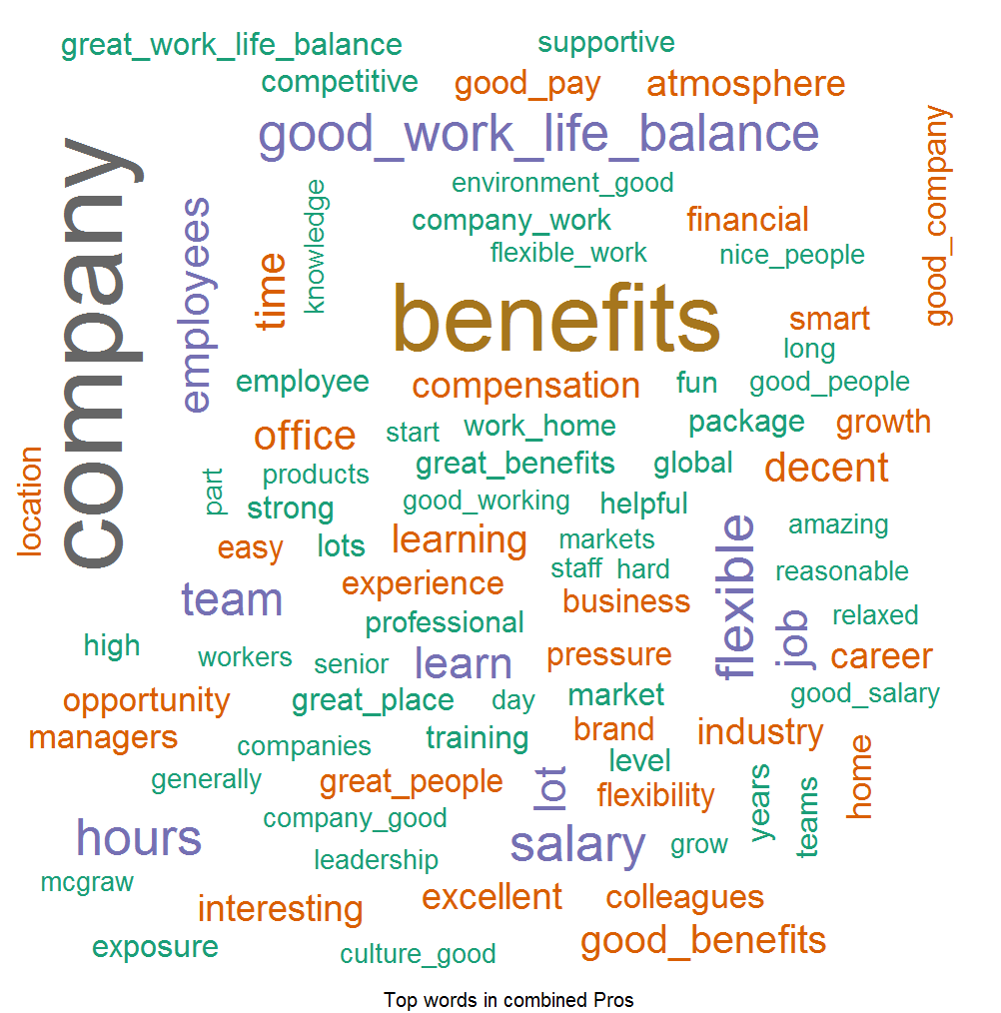
Good Words about the Company
Pros: Things which Employees liked –
According to Employees feedback, we found out that people love our Good Benefits, Good Work Life Balance, Good Company, Leadership, Good People and Opportunities provided by S&P and they are spreading good words on this front.
Cons: Word List which Employees don’t like –
Feedback provided by the Employees they found out to difficulty to cope up with Opportunities, Work Life, HR Processes, Monotonous Work, Growth, Promotions and Layoffs and this can be improved.

Slide 6
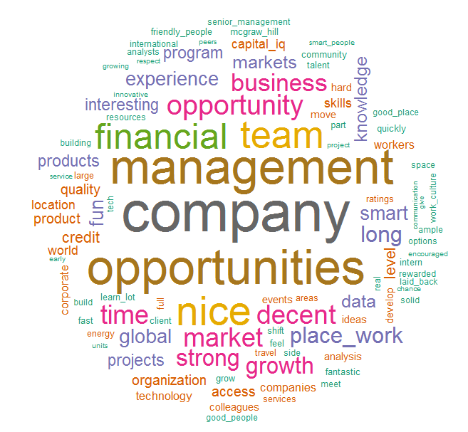
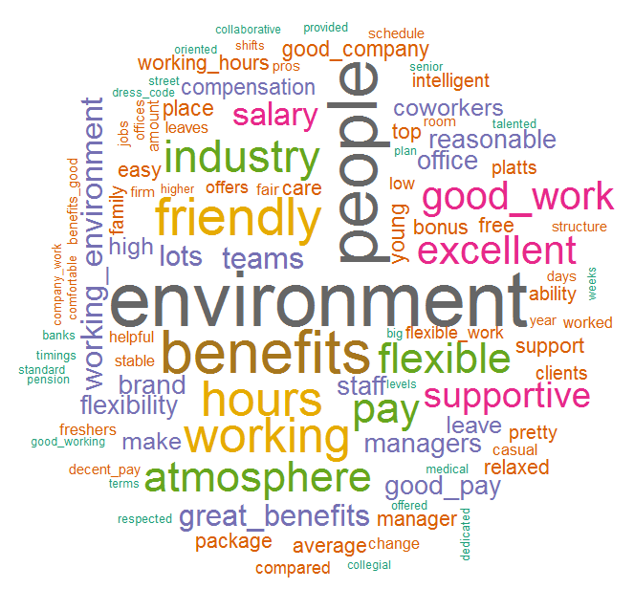
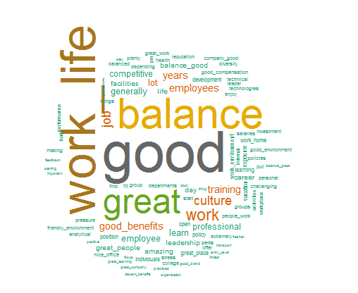
Top 3 Themes – For Pros
We identified three themes, based on word occurrence in collection of positive comments and closeness from other words (Statistically), Which employees liked
Theme 1: Respect to Personal Life
(Work Life balance, Work and Benefits)
Theme 2: Financial Oriented (Benefits, Pay, Salary, Flexibility, Standard Pension etc.)
Theme 3: Equity Brand
( Company, Brand, Opportunity, Management, Global Company etc.)

Slide 7
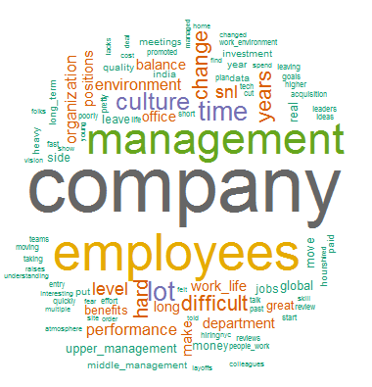
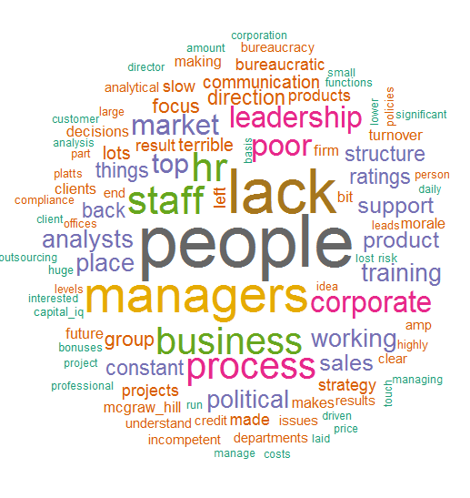
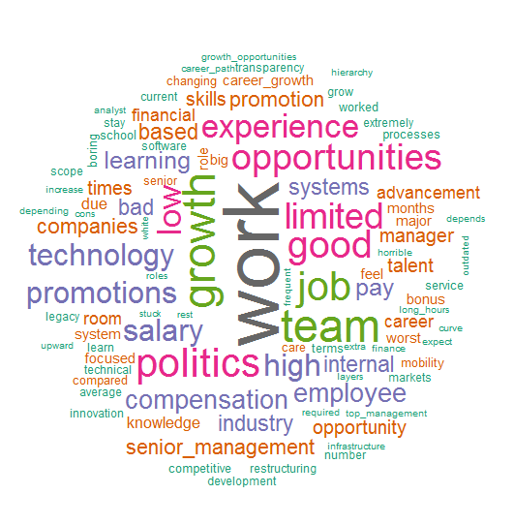
Top 3 Themes – For Cons
We identified three themes based on word occurrence in collection of negative comments and closeness from other words (Statistically), Which employees didn’t liked
Theme 1: Upper Management
(Management, Company, Employees, time etc.)
Theme 2: Immediate Team and Process
(People, Managers, Process etc.)
Theme 3: Growth
(Work, Growth, Opportunities, Promotions, Compensation, Politics etc.)

Slide 8
What US and India Employees liked
What US Employees liked –
Work Life Balance
Good Pay
Good Culture
Great Benefits
Interesting Work
Work Hours
What US Employees didn’t liked –
Growth
Work
Politics
Leadership
Opportunities
Promotions
What India Employees liked –
Work Life Balance
Good Working Environment
Good Culture
Less Work Pressure
Transport Facility
Good Pay
What India Employees didn’t liked –
Not Enough Opportunities
Slow Career / Growth opportunity
Promotion
Monotonous work
Training
Night Shift

Slide 9
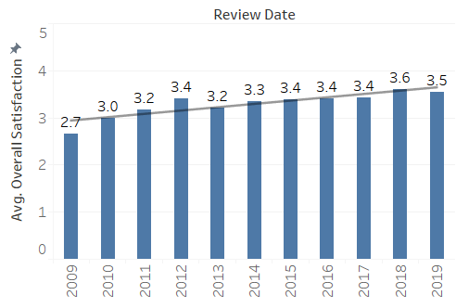
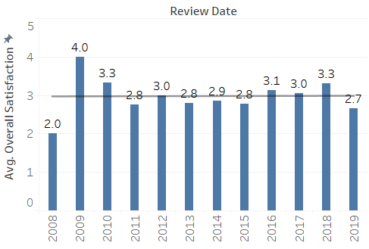
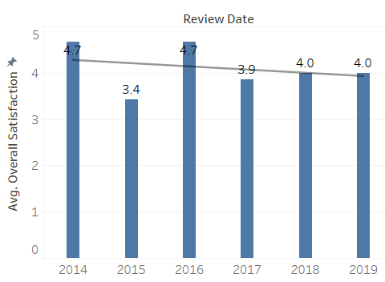
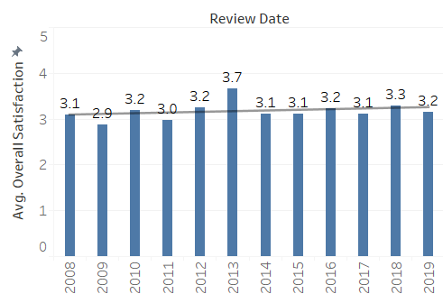
Overall satisfaction for all Division
Avg. Overall Satisfaction in MI
Avg. Overall Satisfaction in Platts
Avg. Overall Satisfaction in DJI
Avg. Overall Satisfaction in Ratings
* For Employees over all satisfaction MI and Ratings divisions saw an increase, Platts shows a constant and DJI shows negative trend.

Slide 10
What Employees liked (based on each division)
What MI Employees liked –
Work Life Balance
Good Work Culture
Great Benefits
Good Work
Good People
Opportunities
What Platts Employees liked –
Good Benefits
Good Work life balance
Good Work
Smart People
Flexible timings
What DJI Employees liked –
Good Benefits
Good Work Life Balance
Good Company
Good Interns
Professional People
Globally renown company
What Ratings Employees liked –
Good Benefits
Good Work Life Balance
Good Company
Learning
Interesting Work
Work From Home
Working hours

Slide 11
What Employees didn’t liked (based on each division)
What MI Employees didn’t liked –
Growth
Lack of Training
Monotonous Work
Bad Managers
Promotions
Salary
What Platts Employees didn’t liked –
Long Hours
Political Manager
Career Progression
Leadership
Salary
What DJI Employees didn’t liked –
Politics
Protected Management
Opportunities
Inequality in pay
Squeaky wheel
What Ratings Employees didn’t liked –
Promotions
Process
Less training
Bonus
Salary
Analytical job without Analytical work

Slide 12
Future Work Opportunities
Analysis of Exit surveys ( VIBE data ) and check “What Employees are talking”. Based on outcome of this analysis, we can measure similarities between both feedbacks.
Analysis of interview / recruitment experience.
EVP analysis and include different Social media channels like – S&P Global Facebook Page, Twitter Feeds etc.
Similar analysis can be performed on the few topics like – onboarding, Movement, orientation, First 30 days experience etc.

Slide 13
Appendix

Slide 14
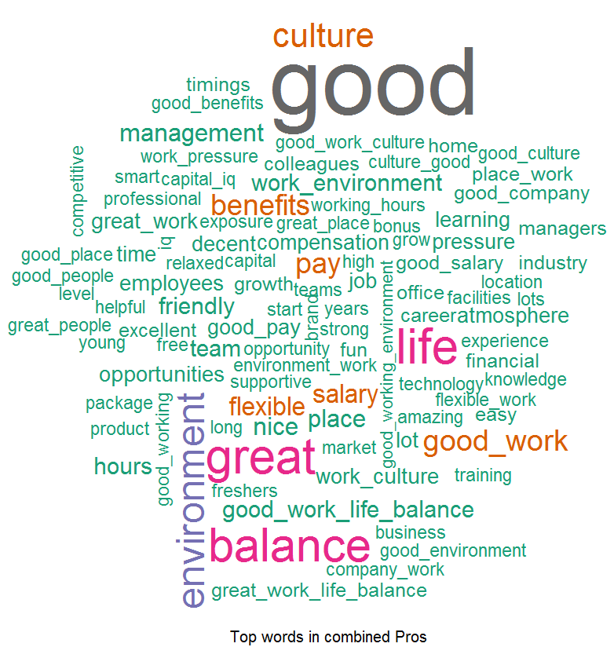
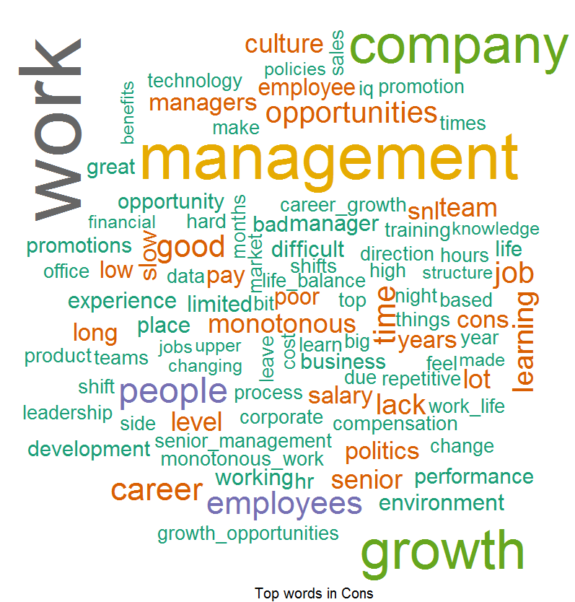
Good Words about the MI
Pros: Things which Employees liked –
According to Employees feedback, we found out that people love our Good Benefits, Good Work Life Balance, Good Work Culture, Good People and Opportunities provided by S&P and they are spreading good words on this front.
Cons: Word List which Employees don’t like –
Feedback provided by the Employees they found out to difficulty to cope up with Opportunities, Growth, Lack of Training, Monotonous Work, Bad Manager, Promotions and Salary and this can be improved.

Slide 15
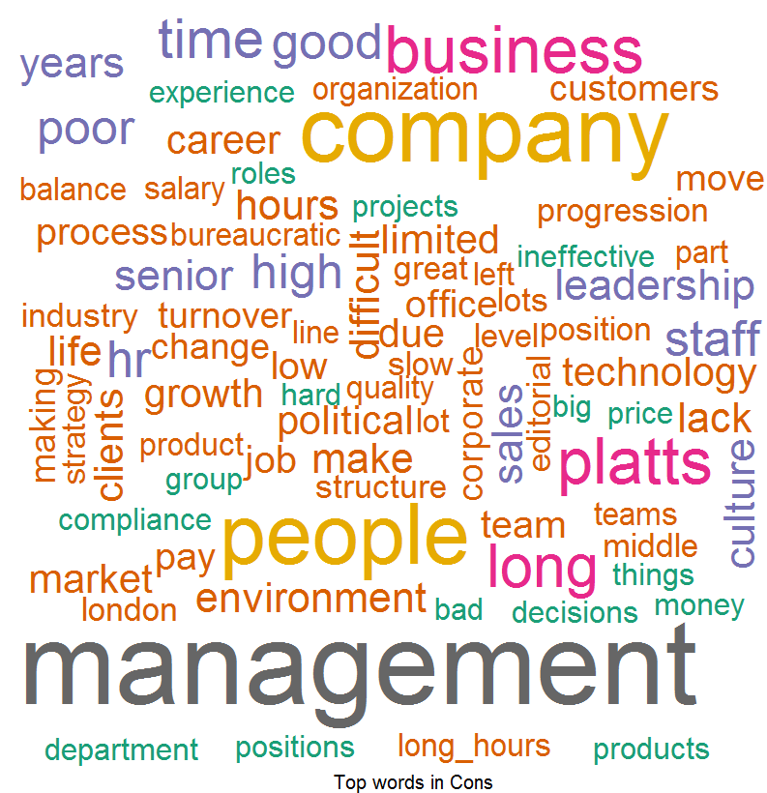
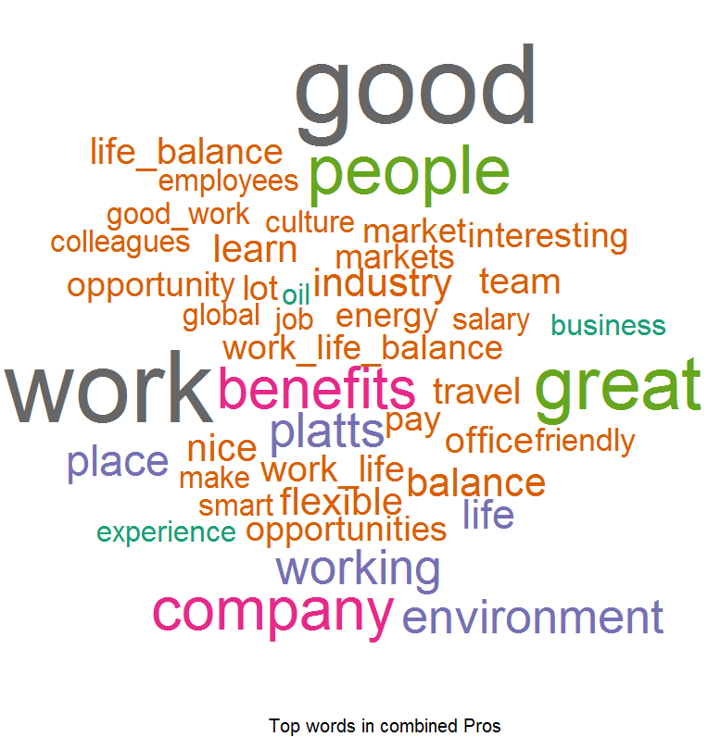
Good Words about the Platts
Pros: Things which Employees liked –
According to Employees feedback, we found out that people love our Good Benefits, Good Work Life Balance, Good Work, Smart People and Flexible time provided by S&P and they are spreading good words on this front.
Cons: Word List which Employees don’t like –
Feedback provided by the Employees they found out to difficulty to cope up with Long Hours, Political Managers, Career Progression and Salary and this can be improved.

Slide 16
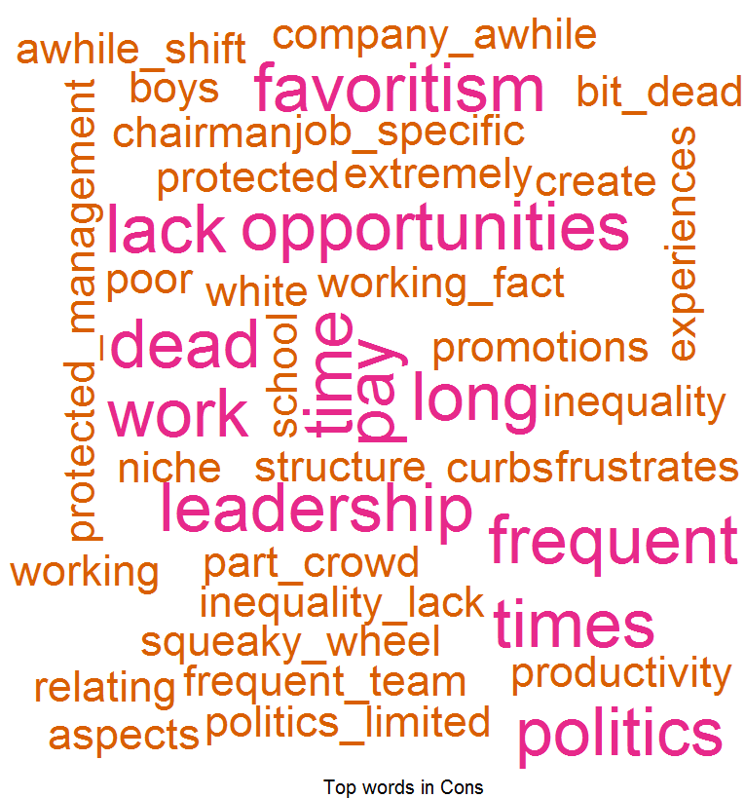
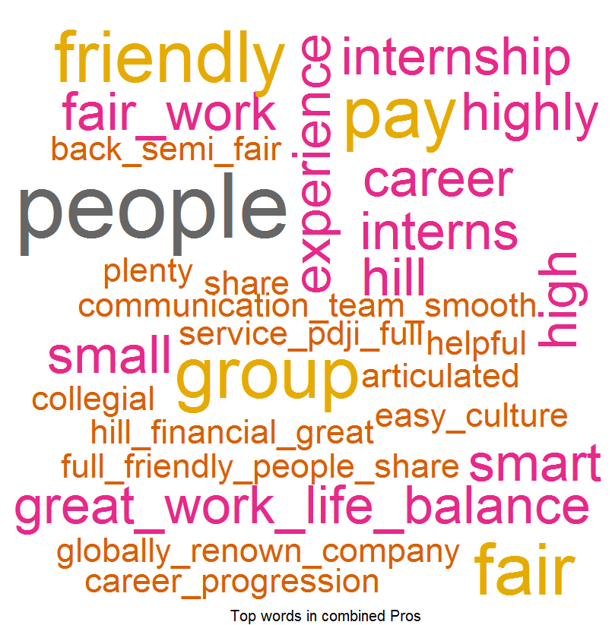
Good Words about the DJI
Pros: Things which Employees liked –
According to Employees feedback, we found out that people love our Good Benefits, Good Work Life Balance, Good company, Good Interns, Professional Peoples, Good Internship and Globally renown company provided by S&P and they are spreading good words on this front.
Cons: Word List which Employees don’t like –
Feedback provided by the Employees they found out to difficulty to cope up with Politics, Protected Management, Opportunities, Promotions, Squeaky wheel and Inequality in pay and this can be improved.

Slide 17
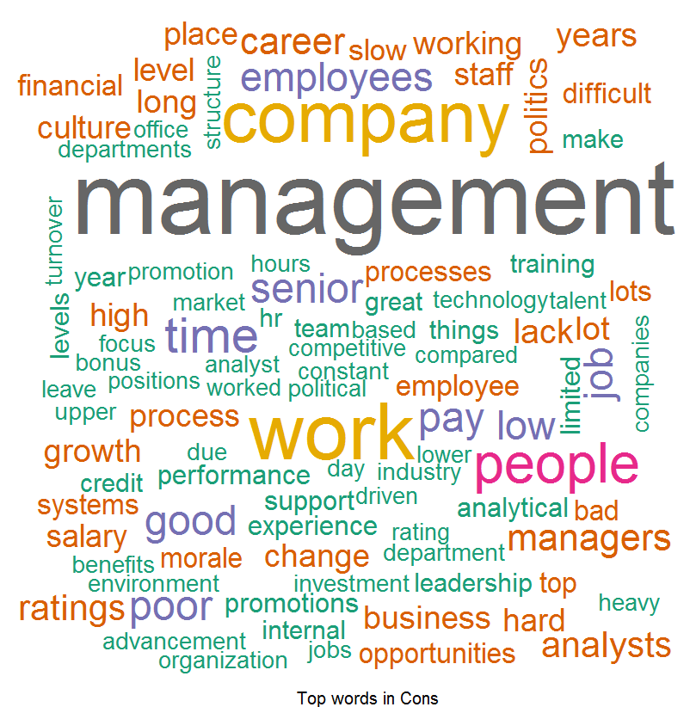
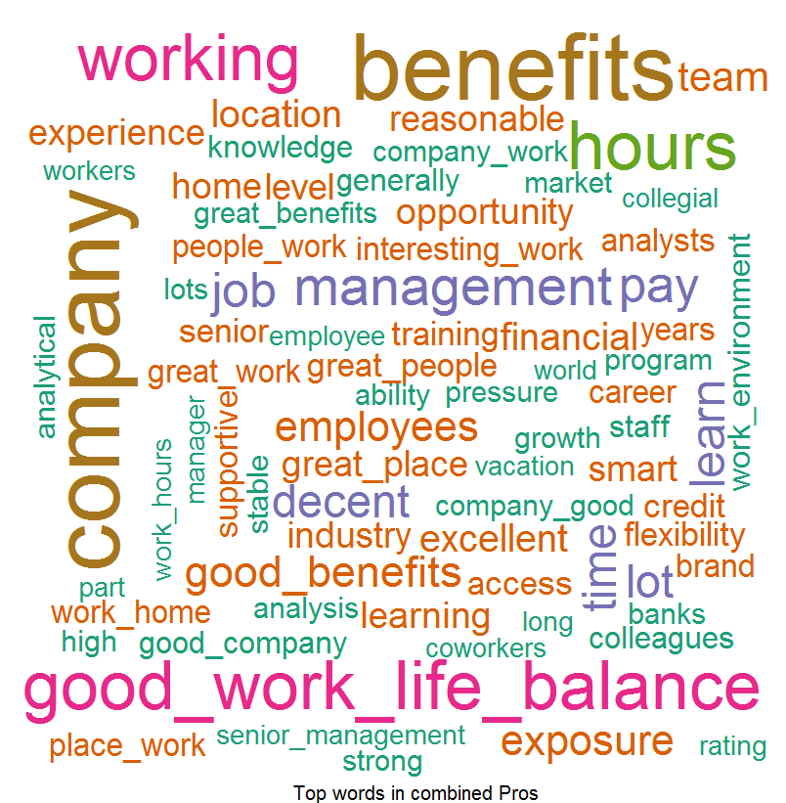
Good Words about the Ratings
Pros: Things which Employees liked –
According to Employees feedback, we found out that people love our Good Benefits, Good Work Life Balance, Good company, Learning, Interesting Work, Work from Home, Working Hours and Office Location provided by S&P and they are spreading good words on this front.
Cons: Word List which Employees don’t like –
Feedback provided by the Employees they found out to difficulty to cope up with Promotions, Processes, Less Trainings, Bonus, Salary and Analytical Job without Analytical work and this can be improved.

Slide 18
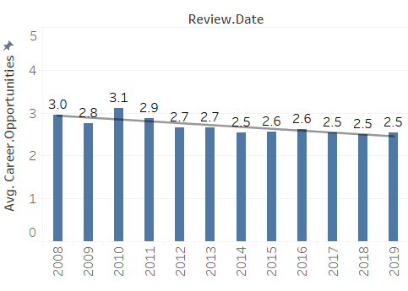
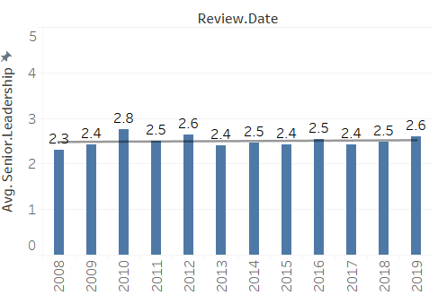
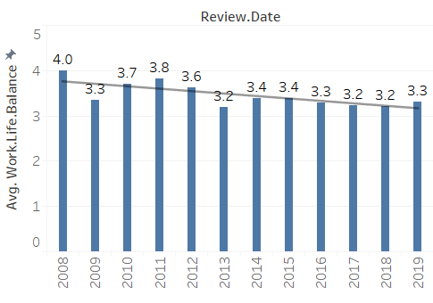
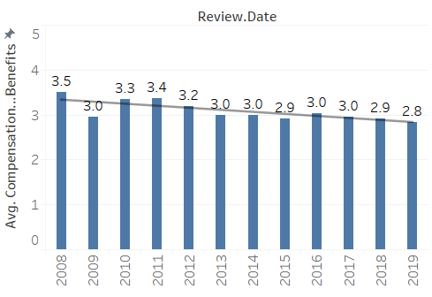
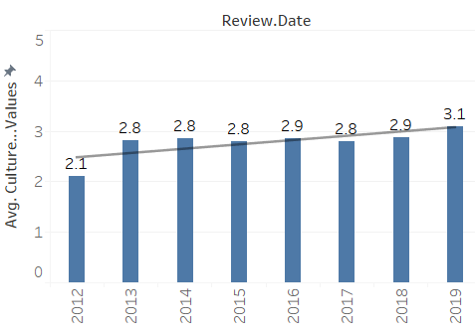
Overview – For 5 Subsections (Overall)
Avg. Career Opportunity over the Years
Avg. Senior Leadership over the Years
Avg. Work Life balance over the Years
Avg. Comp & Benefits over the Years
Avg. Culture & Value over the Years

Slide 19
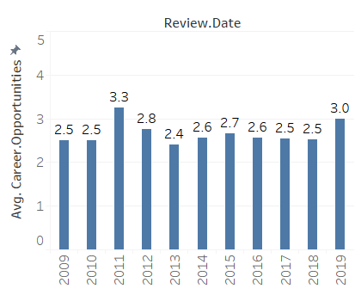
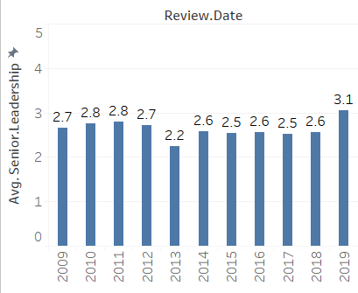
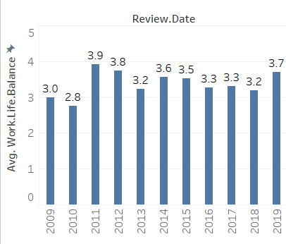
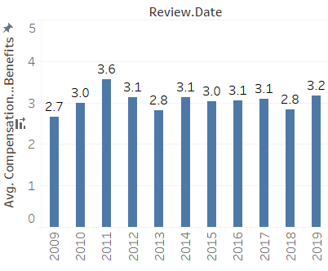
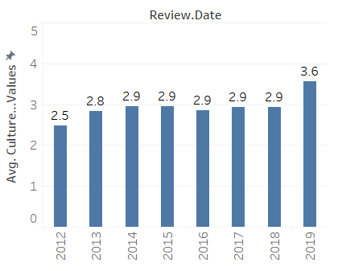
Overview – For S&P MI
Avg. Career Opportunity over the Years
Avg. Senior Leadership over the Years
Avg. Work Life balance over the Years
Avg. Comp & Benefits over the Years
Avg. Culture & Value over the Years

Slide 20
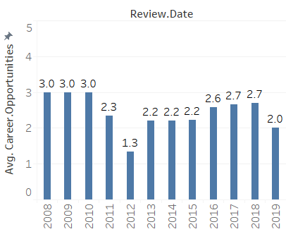
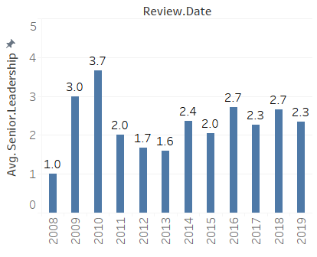
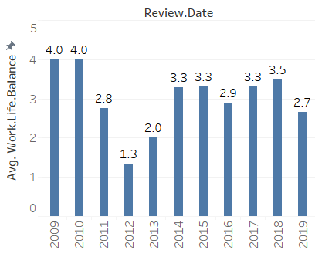
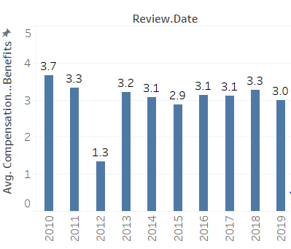
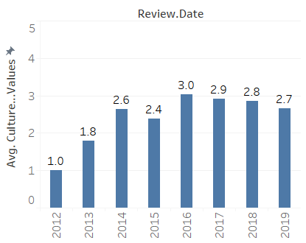
Overview – For S&P Platts
Avg. Career Opportunity over the Years
Avg. Senior Leadership over the Years
Avg. Work Life balance over the Years
Avg. Comp & Benefits over the Years
Avg. Culture & Value over the Years

Slide 21
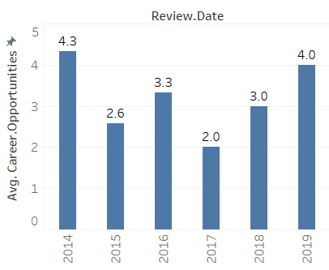
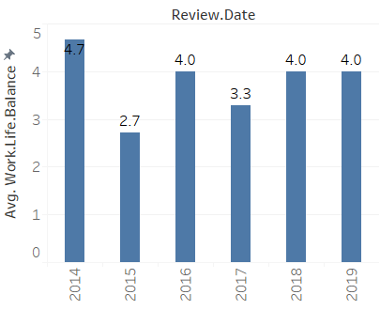
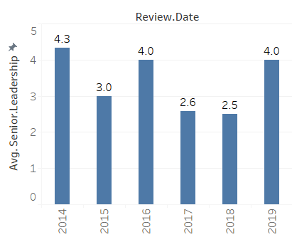
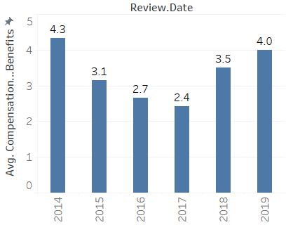
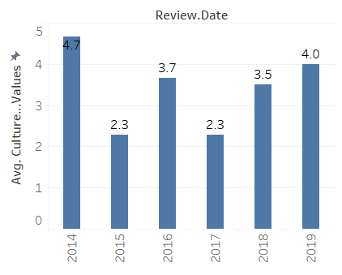
Overview – For S&P DJI
Avg. Career Opportunity over the Years
Avg. Senior Leadership over the Years
Avg. Work Life balance over the Years
Avg. Comp & Benefits over the Years
Avg. Culture & Value over the Years

Slide 22
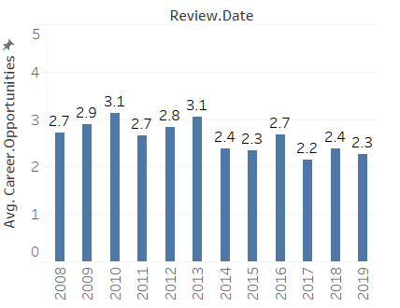
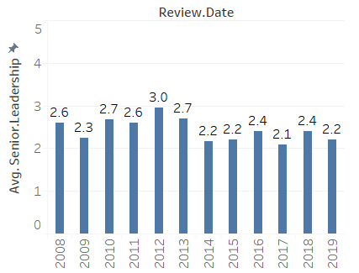
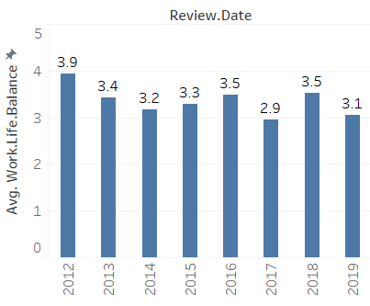
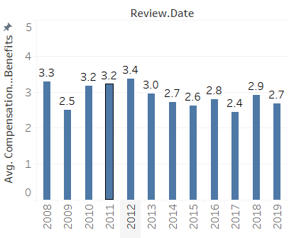
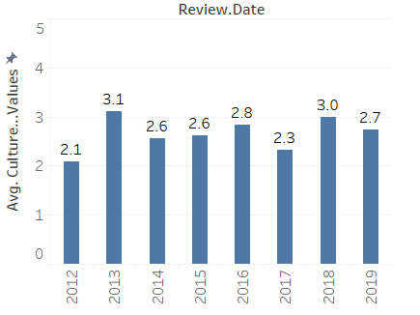
Overview – For S&P Ratings
Avg. Career Opportunity over the Years
Avg. Senior Leadership over the Years
Avg. Work Life balance over the Years
Avg. Comp & Benefits over the Years
Avg. Culture & Value over the Years

Slide 23
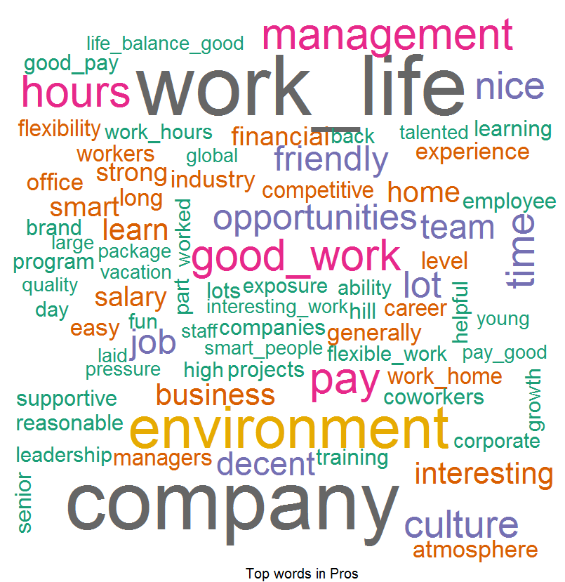
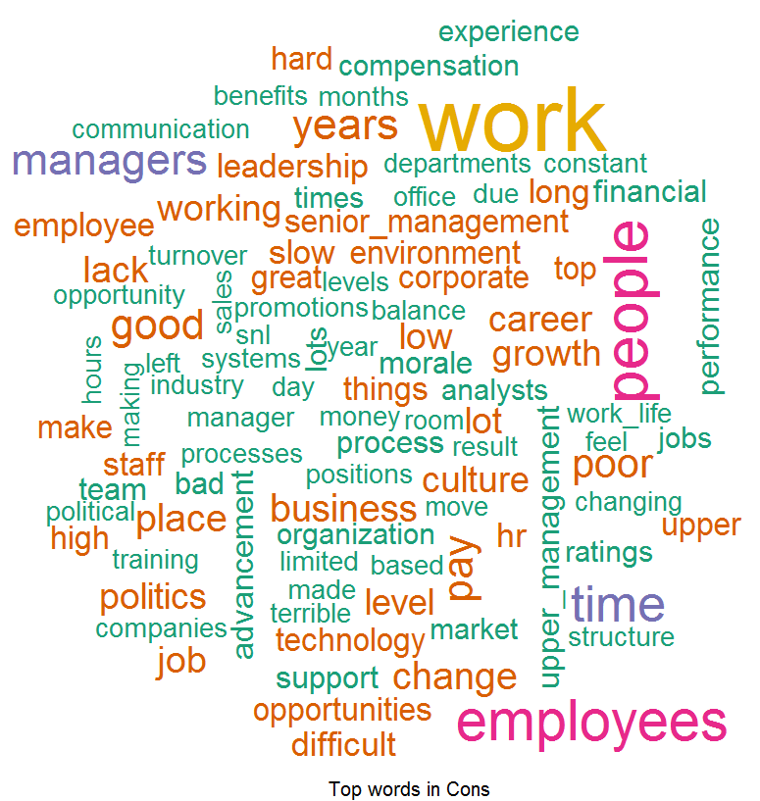
Word Cloud For US
Word Cloud for Pros
Word Cloud for Cons
Good Words List –
Work Life Balance
Good Pay
Good Culture
Great Benefits
Interesting Work
Work Hours
Word List which people don’t like –
Growth
Work
Politics
Leadership
Opportunities
Promotions

Slide 24
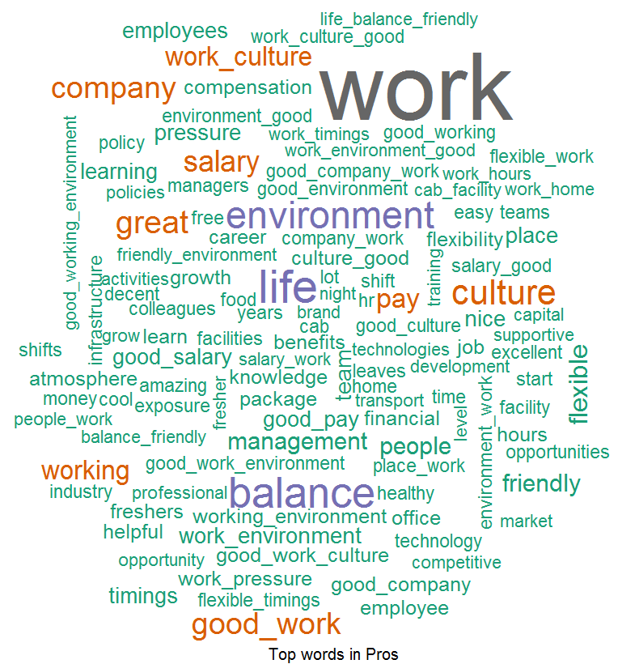
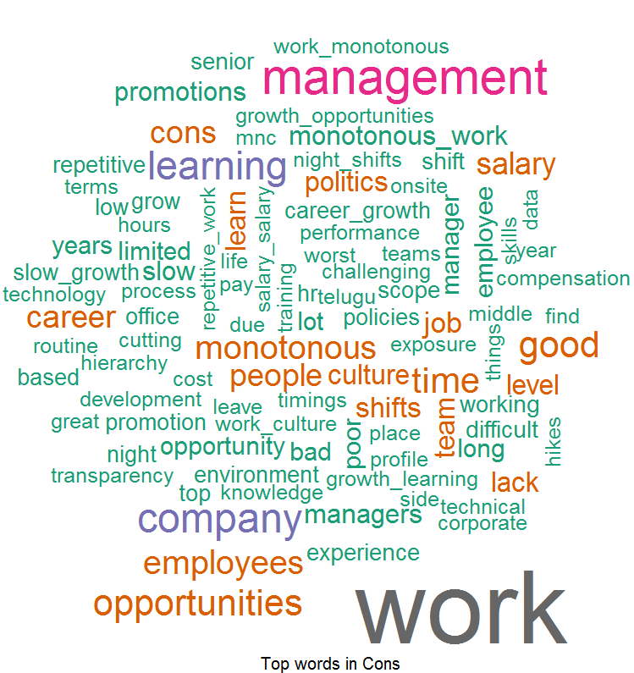
Word Cloud For India
Word Cloud for Pros
Word Cloud for Cons
Good Words List –
Work Life Balance
Good Working Environment
Good Culture
Less Work Pressure
Transport Facility
Good Pay
Word List which people don’t like –
Not Enough Opportunities
Slow Career / Growth opportunity
Promotion
Monotonous work
Training
Night Shift

Slide 25
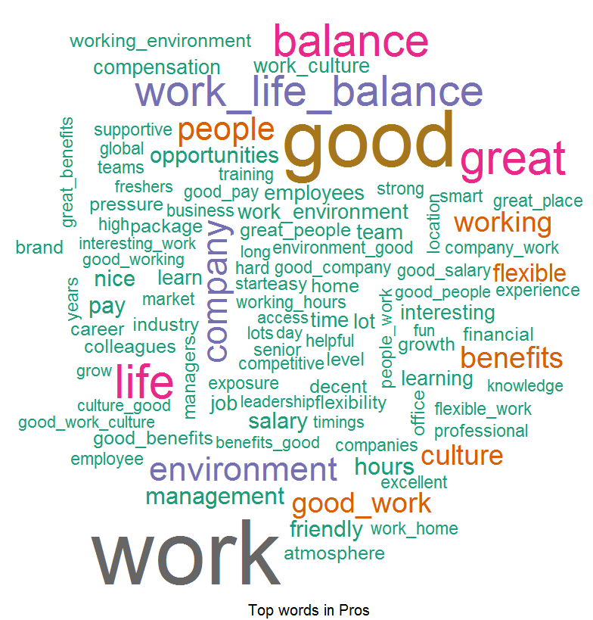

Word Cloud For Current Employees
Word Cloud for Pros
Word Cloud for Cons
Good Words List –
Work Life Balance
Good Work
Good Work Culture
Good Benefits
Flexible Time
Work From Home
Word List which people don’t like –
Career Growth opportunities
Opportunities
Not Enough Learning
Training
Politics

Slide 26


Word Cloud For Former Employees
Word Cloud for Pros
Word Cloud for Cons
Good Words List –
Work Life Balance
Work Environment
Good Benefits
Flexibility
Great Company
Word List which people don’t like –
Growth
Culture
Politics
Opportunity, Promotion
Learning / Training

